Slide 1

Index Revisions and Stock Returns

Slide 2
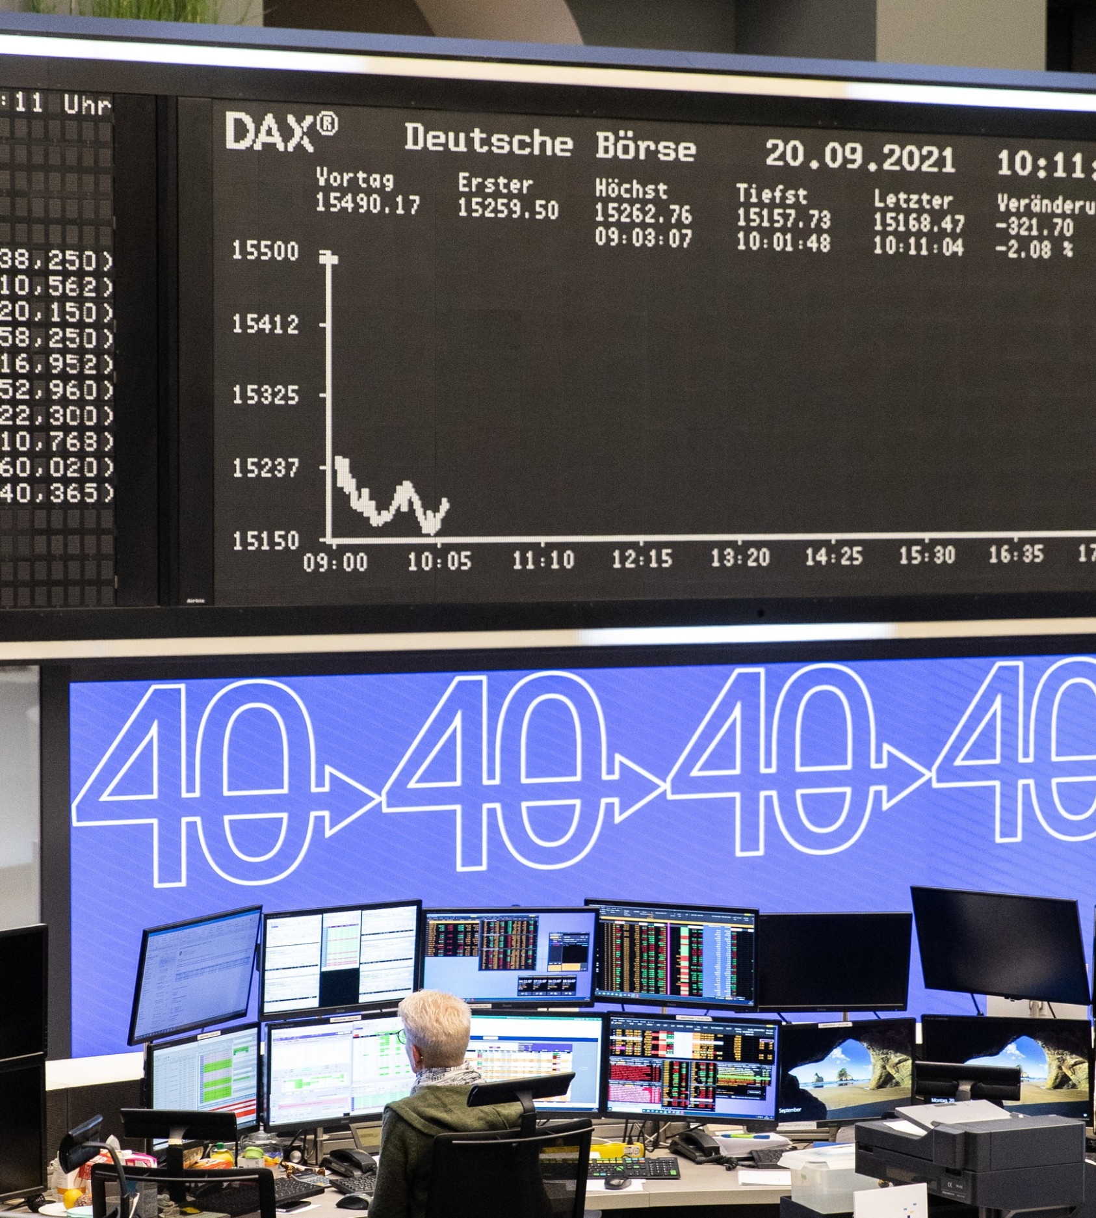
Agenda
Executive Summary
Introduction
Background
Data Basis
Outlier Detection
Analyses
Short Term Effects
Market Correlation
Systematic Risk
Conclusion

Slide 3
Executive Summary
Executive Summary
Based on previous work regarding inclusion effects in the S&P500, we analysed the German DAX to see if the same effects can also be observed. Our analysis addresses the inclusion effects of three areas: short term effects, market correlation and systematic risk.
DATA BASIS
Historical data of all companies in the DAX from 01.01.2008 until 01.03.2022. Inclusion and exclusion information was obtained from the Deutsche Börse. Data was interpolated and scanned for outliers.
SHORT TERM EFFECTS
47%
Increase in vol.
Trading volume increases after an addition to the DAX. In contrast to our expectations returns and return volatility did not increase. However, these results should be treated with care since the small sample size might be a reason for non significant results.
MARKET CORRELATION
0.00
Corr. delta
We analysed the change in correlation of every stock with the market for their inclusion/exclusion and announcement date, being aware that multicollinearity affects our results. Due to the small sample size we could not detect any reasonable effects.
SYSTEMATIC RISK
0.23
Increase in beta
After analysing the systematic risk for DAX stocks that were included/excluded from the index, we can confirm previous findings regarding the increase/decrease in the β-coefficients. Especially after the DAX30 to DAX40 increase, we see a steep increase in beta.

Slide 4

Introduction

Slide 5
Background
introduction
Lawrence Harris et al.
William B. Elliott et al.
The authors examined in their publication from 1986 the Price & Volume Effects of new inclusions into the S&P 500. Their key findings were:
Immediately after an addition is announced, prices increase by more than 3 percent
This increase is nearly fully reversed after 2 weeks.
In 2006, Elliott and his peers, wanted to understand what Drives the Inclusion Effect discovered in earlier papers. Their key findings were:
Increased investor awareness is the primary factor behind the abnormal announcement returns
Around the inclusion date price pressure can be observed
No evidence that anticipated improvements in operating performance, or increased liquidity are related to the announcement or inclusion returns
Hypothesis: Similar to the S&P 500 we would expect to observe the same inclusion effects in Germany in the DAX. Furthermore, we anticipate changes in the correlation with the DAX as well as changes in the systematic risk after a DAX inclusion.
Note: As the DAX is way smaller than the S&P500 the sample size for new inclusions is also smaller and might be a potential pitfall in our analysis.

Slide 6

Data Basis
Introduction
Reuters (Datastream)
Inclusions and Exclusions
The historical data for all companies that have been in the DAX was downloaded via Datastream from Reuters¹
Time horizon: 01.01.2008 – 01.03.2022. Due to mergers or bankruptcies data further back was not accessible with our Reuters access rights
Adjusted Close
Daily Volume
Data was splined and analysed for outliers. Wirecards data for volume was interpolated linearly because too many data points were missing
The Deutsche Börse provides an official list with all inclusions into the DAX over the years:
The first exchange in the scope of our analysis was the replacement of Salzgitter AG with Heidelberg Cement AG on 21.06.2010
Since 2010, over 22 companies have been introduced to the DAX. Usually around 1 exchange per year.
10 companies got excluded from the DAX
The biggest change was the increase from 30 to 40 companies in September 2021
Puma AG²
Date | Adj. Close | Volume
01.01.2008 | 27,326 | 323150
… | … | …
01.03.2022 | 76,44 | 815822
¹Due to mergers, MAN and METRO were excluded ²Data of Puma also from 2008 on, even though the inclusion was only in 2021
Source: https://www.dax-indices.com/document/Resources/Guides/Historical_Index_Compositions_20.12.2021.pdf

Slide 7
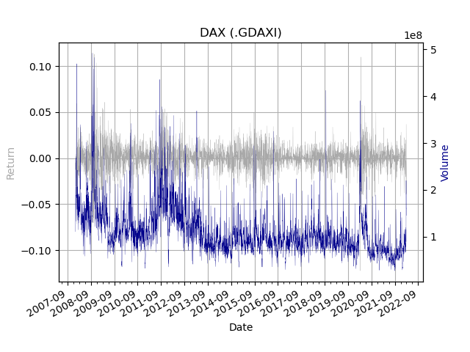
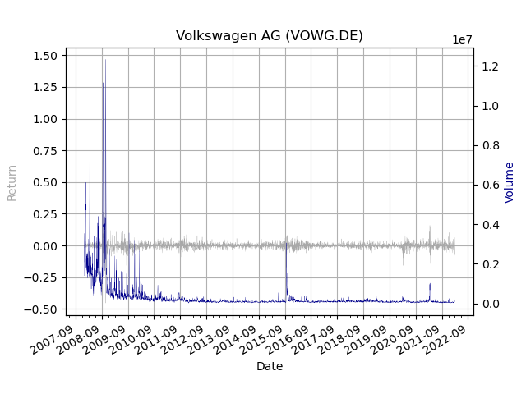
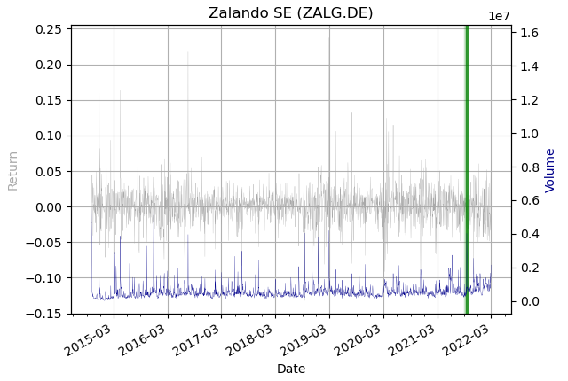
Outlier detection
Introduction
Daily Returns and Volume of the DAX
We analysed the data in regard to outliers both visually & analytically¹.
In the visualization of the DAX, we could not detect any unexplainable outliers. For example:
Volume with stronger movement around 2008 and 2012 due to the Financial and Euro crisis
COVID-19 impact can be observed
DAX Returns
Observations | 3592
Highest daily loss | 12.24%
Highest daily gain | 11.40%
Daily avg. return | 0.02%
Std. deviation | 1.41
Daily Returns and Volume of Siemens AG and Zalando SE
Exemplary view on Volkswagen and Zalando:
Volkswagen with a spike in volume around the short squeeze in 2008
Available data for Zalando only started in 2015. Not a problem as the DAX inclusion happened in 2021 (green line)
Obvious outliers Date of announcement for of inclusion Date of inclusion
¹Considering seasonality effects and the trend of the stock, we determined whether the change in return and volume differed unexplainably strong from the previous day

Slide 8
Short term effects

Slide 9
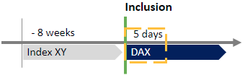
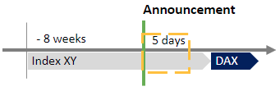

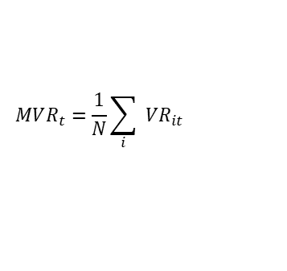
Short term effects: Volume
SHORT Term Effects
Methodology
The Mean Volume Ratio is a market adjusted ratio between the volume traded in a time period after an event and the mean volume traded in the 8 weeks before said event.
$$MVR_{t}=\frac{1}{N}\sum_{i}{ VR_{it}}$$
$$VR_{it}= \frac{V_{it}}{V_{mt}}∗\frac{V_{m}}{V_{i}}$$
1)
2)
Inclusion Day
Announcement Day
Hypothesis: Volume increases after being included into an index due to, among others, public and private index funds.
Hypothesis: Compared to the inclusion day effects should be less severe as most investors are already aware of the inclusion and fund effects do not apply yet.
 |  | Day 1 | Day 1 | Day 1-5
 | N | mvr | σ | mvr | σ
Included | 22 | 1.47 | 1.80 | 1.11 | 0.92
Included 40 | 10 | 0.87 | 0.16 | 0.88 | 0.23
Included Rest¹ | 12 | 1.98 | 2.35 | 1.31 | 1.20
Excluded | 10 | 0.88 | 0.47 | 0.76 | 0.34
 |  | Day 1 | Day 1 | Day 1-5
 | N | mvr | σ | mvr | σ
Included | 22 | 1.64 | 0.88 | 1.32 | 1.10
Included 40 | 10 | 1.79 | 1.22 | 1.22 | 0.76
Included Rest¹ | 12 | 1.53 | 0.48 | 1.40 | 1.32
Excluded | 10 | 1.47 | 1.37 | 1.35 | 1.30
¹ All inclusions beside the DAX30 to 40 revision

Slide 10
Short term effects: Returns
short term effects
Hypothesis: Due to the increase in volume (demand) the prices/returns should also increase.
Inclusion Day
Announcement Day
Results
Looks like prices tend to rise on the first day after inclusion and then drop
All T-tests failed to reject H0
Results
The output indicates no direct effect on returns
All T-tests failed to reject H0
 |  | Day 1 | Day 1 | Day 1-5
 | N | μ (%) | σ | μ (%) | σ
Included | 22 | 0.81 | 2.23 | -0.25 | 2.07
Included 40 | 10 | 1.20 | 1.84 | -0.25 | 2.27
Included Rest¹ | 12 | 0.48 | 2.54 | -0.24 | 1.91
Excluded | 10 | -1.24 | 2.46 | -1.70 | 5.35
 |  | Day 1 | Day 1 | Day 1-5
 | N | μ (%) | σ | μ (%) | σ
Included | 22 | 0.15 | 2.43 | -0.03 | 1.92
Included 40 | 10 | 0.90 | 2.70 | 0.08 | 1.62
Included Rest¹ | 12 | -1.36 | 1.57 | -0.12 | 2.14
Excluded | 10 | -0.68 | 4.53 | -0.53 | 4.02
¹ All inclusions beside the DAX30 to 40 revision

Slide 11
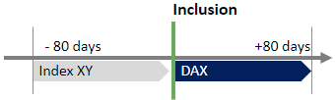
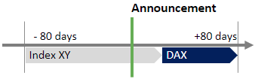
Short term effects: Volatility
Short term effects
Hypothesis: Increasing trading volumes generally result in higher return volatility. Hence, for both events we would expect to observe an increase in return volatility.
Inclusion Day
Announcement Day
Results²
No increase in volatility
Return volatility is not influenced by the inclusion
Results²
No increase in volatility either
Return volatility is not influenced by the announcement
 |  | 5 Days | Day 1 | 80 Days
 | N | μ | σ | μ | σ
Included | 22 | 0.000 | 0.009 | 0.001 | 0.006
Included 40 | 10 | -0.001 | 0.008 | 0.005 | 0.004
Included Rest¹ | 12 | 0.001 | 0.010 | -0.002 | 0.005
Excluded | 10 | 0.005 | 0.014 | -0.017 | 0.049
 |  | 5 Days | Day 1 | 80 Days
 | N | μ | σ | μ | σ
Included | 22 | 0.000 | 0.011 | 0.002 | 0.006
Included 40 | 10 | -0.001 | 0.006 | 0.005 | 0.004
Included Rest¹ | 12 | 0.000 | 0.013 | -0.002 | 0.005
Excluded | 10 | 0.005 | 0.023 | -0.016 | 0.049
¹ All inclusions beside the DAX30 to 40 revision
² The values below are the means and standard deviations of the differences between return standard deviations over a specific timeframe before and after an event.

Slide 12
Market correlation

Slide 13
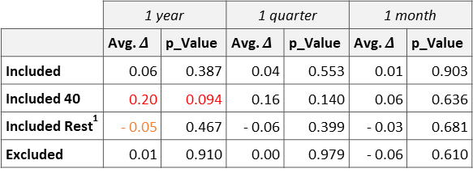
Market correlation: Day of Inclusion/Exclusion
Market correlation
Hypothesis: Included companies start to correlate stronger with the market once they are included in the index.
Methodology
Correlation effect 1 year before and 1 year after inclusion/exclusion
Pearson correlation of the returns between the DAX and the stock
Multicollinearity is by definition “a problem”
Results
Results for Included Rest really unintuitive to be negative
Monthly view: no real change in correlation visible/detectable
DAX30 to DAX40 revision appears to be exceptional due to higher mass of included companies
Exclusion seems to have no big impact on the correlation
No significance whatsoever: small sample size
 | 1 year |  | 1 quarter |  | 1 month
 | Avg. $Δ$ | p_Value | Avg. $Δ$ | p_Value | Avg. $Δ$ | p_Value
Included | 0.06 | 0.387 | 0.04 | 0.553 | 0.01 | 0.903
Included 40 | 0.20 | 0.094 | 0.16 | 0.140 | 0.06 | 0.636
Included Rest¹ | - 0.05 | 0.467 | - 0.06 | 0.399 | - 0.03 | 0.681
Excluded | 0.01 | 0.910 | 0.00 | 0.979 | - 0.06 | 0.610
Impact Inclusion Day
¹ All inclusions beside the DAX30 to 40 revision

Slide 14
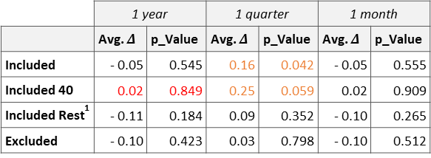
Market correlation: Day of Announcement
Market correlation
Hypothesis: Announcements are often an “open” secret thus no big effect can be observed with this date.
Methodology
Correlation effect 1 year before and 1 year after announcement
Pearson correlation of the returns between the DAX and the stock
Multicollinearity is by definition “a problem”
Results
Yearly view now highly unsignificant: this shows the problematic size of the sample (compare Included 40 to previous one)
Quarterly view produces the most significant results
Possible explanation: Announcement reduces uncertainty in stocks
DAX30 to DAX40 revision still appears to produce a bigger delta in correlation
Exclusions still don’t show any effect or tendency
 | 1 year |  | 1 quarter |  | 1 month
 | Avg. $Δ$ | p_Value | Avg. $Δ$ | p_Value | Avg. $Δ$ | p_Value
Included | - 0.05 | 0.545 | 0.16 | 0.042 | - 0.05 | 0.555
Included 40 | 0.02 | 0.849 | 0.25 | 0.059 | 0.02 | 0.909
Included Rest¹ | - 0.11 | 0.184 | 0.09 | 0.352 | - 0.10 | 0.265
Excluded | - 0.10 | 0.423 | 0.03 | 0.798 | - 0.10 | 0.512
Impact Announcement Day
¹ All inclusions beside the DAX30 to 40 revision

Slide 15
Systematic Risk

Slide 16
Systematic Risk: Methodology
Systematic Risk
Hypothesis: Stocks that get included into an index see their systematic risk increase. Vice versa the systematic risk for excluded stocks decreases.
Methodology
Ralf Hermann
Again, we look at the inclusion/exclusion date, as well as the announcement date
Regression¹ horizon is ±1 period around the event
We looked at 2 different periods: 1 year & 1 quarter. 1 month is too short for a regression as the sample size would be too small
MSCI Germany as a good benchmark, representing over 85% of the German market. Investors point of view
Hypothesis function:
The empirical study from 1997 analysed the systematic risk component of stocks introduced to the DAX. Their key findings were:
Significant increase in the systematic risk of the individual stocks and the portfolio
This increase is even stronger for stocks with a high index weight
Excess return
Change of systematic risk
Unsystematic risk
$$R_{s}=α_{s,0}+α_{s,1}D+β_{s,0}R_{m}+β_{s,1}DR_{m}+ε_{s}$$
Change of excess return since inclusion
Dummy variable
¹ OLS in conjunction with a correction procedure for serially correlated error terms. (Newey/West)

Slide 17
Systematic Risk: General Results
Systematic Risk
Inclusion Day
Announcement Day
Overall systematic risk (beta) increases by 0.13
5 out of 22 DAX stocks show a significant (<5%) increase in their systematic risk (3 out of 10 shows a significant decrease)
Overall systematic risk (beta) increases by 0.11
4 out of 22 DAX stocks show a significant (<5%) increase in their systematic risk (1 out of 10 shows a significant decrease)
 | 1 year |  | 1 quarter
 | Avg. | R² | Avg. | R²
Included | 0.13 | 0.261 | 0.08 | 0.312
Covestro AG | 0.55 | 0.351 | 0.45 | 0.232
MTU Aero Engines AG | 0.43 | 0.427 | 0.06 | 0.902
... | ... | ... | ... | ...
Zalando SE | 0.27 | 0.423 | 0.53 | 0.317
Excluded | -0.02 | 0.281 | -0,10 | 0,314
 | 1 year |  | 1 quarter
 | Avg. | R² | Avg. | R²
Included | 0,11 | 0,264 | -0,23 | 0,325
Covestro AG | 0.51 | 0.351 | -0.66 | 0.582
MTU Aero Engines AG | 0.42 | 0.425 | -0.21 | 0.271
... | ... | ... | ... | ...
Zalando SE | 0.20 | 0.529 | -1.13 | 0.202
Excluded | 0,02 | 0,278 | -0,06 | 0,322

Slide 18
Systematic Risk: DAX30 to DAX40 revision
Systematic Risk
Inclusion Day
Announcement Day
Overall systematic risk (beta) increases by 0.23
4 out of 10 DAX stocks show significant (<5%) increase in their systematic risk
Index weight has no impact on the beta change
Overall systematic risk (beta) increases by 0.19
None of the 10 DAX stocks show significant (<5%) increase in their systematic risk
Index weight has no impact on the beta change
 | 1 year |  | 1 quarter
 | Avg. | R² | Avg. | R²
Included | 0.13 | 0.261 | 0.08 | 0.312
Included 40 | 0.23 | 0.199 | 0.00 | 0.267
1-5 by weight | 0.24 | 0.321 | -0.08 | 0.388
6-10 by weight | 0.22 | 0.079 | 0.09 | 0.146
Included Rest¹ | 0.05 | 0.313 | 0.00 | 0.337
Excluded | -0.02 | 0.281 | -0.10 | 0.314
 | 1 year |  | 1 quarter
 | Avg. | R² | Avg. | R²
Included | 0.11 | 0.264 | -0.22 | 0.352
Included 40 | 0.19 | 0.199 | -0.31 | 0.246
1-5 by weight | 0.22 | 0.316 | -0.08 | 0.388
6-10 by weight | 0.17 | 0.082 | -0.57 | 0.129
Included Rest¹ | 0.04 | 0.318 | -0.02 | 0.358
Excluded | 0.02 | 0.278 | -0.06 | 0.322
¹ All inclusions beside the DAX30 to 40 revision

Slide 19
Conclusion

Slide 20

Conclusion
Conclusion
SHORT TERM EFFECTS
The traded volume notably increases after the analysed events. Contrary to previous papers, we could not observe the same price pressure effects.
MARKET CORRELATION
We were able to observe some intuitive tendencies. Still the limitations due to the small sample size denied a deeper understanding of the underlying effect.
SYSTEMATIC RISK
There is a notable increase in systematic risk after the inclusion in the index. However only a fraction of the stocks showed significant results.
Overall, we were able to confirm some findings from previous papers regarding the S&P 500. However, as only a small number of index revisions occurred in the DAX, the predictive power is limited. Thus, further research is necessary to make reliable conclusions.
Further research possibilities
Analyse if the reversal effects, observed in previous papers, also exist in the DAX
Include a longer time period (>20 years) and thus higher sample size
Consider another European index, with a bigger market, e.g., EURO STOXX 600

Slide 21




Frankfurt School of Finance & Management gGmbH
Adickesallee 32-34 60322 Frankfurt am Main
Applied Data Science (Intake 2021)
Dennis Blaufuss | dennis_simon_merlin.blaufuss@fs-students.de
Lars Wrede | lars.wrede@fs-students.de
Nicolas Kepper | nicolas.kepper@fs-students.de
Philipp Voit | philipp.voit@fs-students.de
Sophie Merl | sophie.merl@fs-students.de
GitHub Repository: https://github.com/LarsWrede/GSFM

Slide 22
Backup

Slide 23
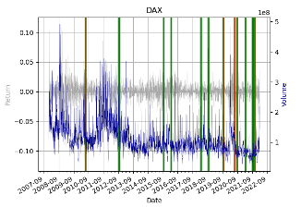
Backup

Slide 24
Backup

Slide 25
Copy Spaghetti
Inclusion
Announcement
Inclusion
- 365 days
+365 days
- 80 days
+80 days
- 365 days
+365 days
Index XY
DAX
Index XY
DAX
DAX30
DAX40
Inclusion
Announcement
Exclusion
- 365 days
+365 days
- 80 days
+80 days
- 365 days
+365 days
DAX
Index XY
Index XY
DAX
DAX30
DAX40
Inclusion
Announcement
- 8 weeks
5 days
- 8 weeks
5 days
Index XY
DAX
Index XY
DAX
Inclusion
Announcement
5 days
5 days
Index XY
DAX
Index XY
DAX

